Slide 1

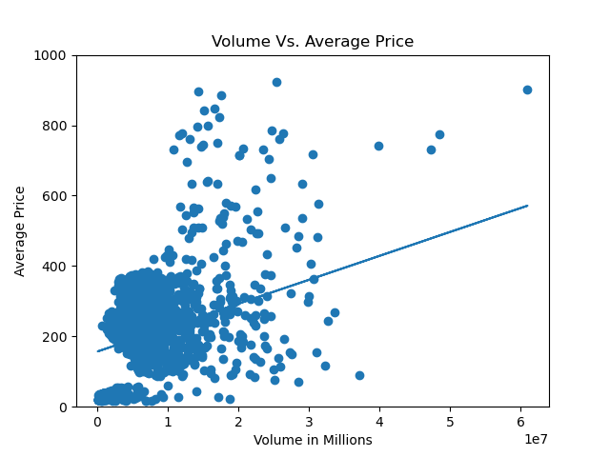
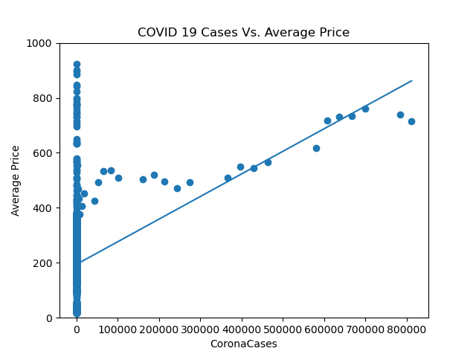
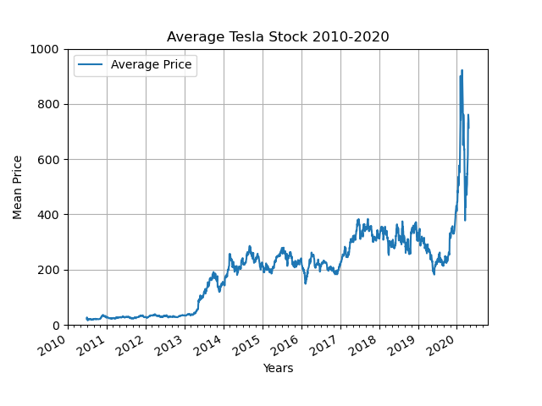
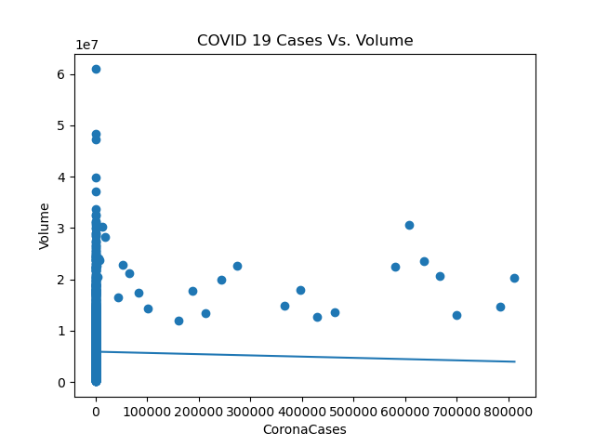
Python 2 APL Final Project Tesla Stock Correlation to
Sean Kim
The Johns Hopkins Applied Physics Laboratory STEM Academy
Background
Analysis
Predicting the direction of the Tesla stock
Requirements: Import data, conduct basic statistical analysis, plot representing visuals, and make conclusions about dataset
Stock is currently in a large uptrend
Lots of deviation within the data
Minimal correlation coefficients and large standard deviation values
Unreliable data
Results
Data shows that there is a:
positive correlation between volume and stock price
minimal correlation between COVID 19 cases and volume
minimal correlation between COVID 19 Cases and average stock price
About the Data
Conclusion
Tesla dataset from June 2010-May 2020. NASDAQ
US Coronavirus dataset from January 2020-April2020. Kaggle
Images and text

